Slide 1


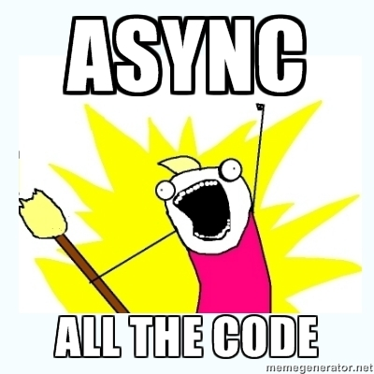
ASP.NET MVC AJAX
Pavel Kolev
Senior .Net
Developer and Trainer
http://pavelkolev.com
Telerik Software Academy

Slide 2

Table of Contents
AJAX
ASP.NET MVC AJAX
ASP.NET WEB API
ASP.NET SPA
ASP.NET SIGNALR

Slide 3
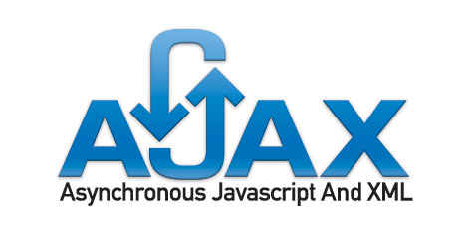
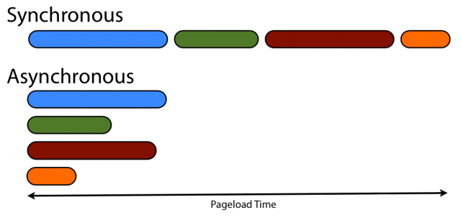
AJAX

Slide 4
What is AJAX
AJAX - Asynchronous JavaScript and XML
With Ajax, web applications can send data to, and retrieve data from, server asynchronously (in the background)
AJAX is a combination of technologies
HTML and CSS for markup
DOM for display & interaction
XMLHttpRequest for async communication
JS for tying it all together

Slide 5

The XMLHttpRequest object
Used to send HTTP or HTTPS requests directly to a web server
The data might be received from the server as JSON, XML, HTML, or as plain text.
Requests will only succeed if they are made to the same server that served the original web page

Slide 6

AJAX Pitfalls
Increased load on webserver
Harder to debug
Harder to test
No back button
Support Non-Ajax clients

Slide 7
AJAX Libraries
Google Web Toolkit
Direct Web Remoting
AJAX.Net
Microsoft Ajax Extensions for ASP.NET

Slide 8
Partial Rendering & JavaScript Rendering
Partial Rendering - Making an asynchronous request to the server which replies with a chunk of HTML markup
JavaScript Rendering - retrieve the raw data that you’d like to display, then use that data to create and update HTML elements by manipulating the DOM directly
$("#container").load('ajax_content.html')
$.getJSON(url [data], success(data, textStatus, jqXHR))

Slide 9
JavaScript Rendering Example
$.getJSON('ajax/test.json', function(data) {
var items = [];
$.each(data, function(key, val) {
items.push('<li id="' + key + '">' + val + '</li>');
});
$('<ul/>', {
'class': 'my-new-list',
html: items.join('')
}).appendTo('body');
});

Slide 10
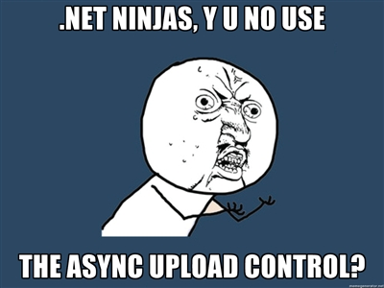
ASP.NET MVC AJAX

Slide 11
ASP.NET AJAX
A framework for building cross-platform, Ajax-enabled, rich web applications
Included with .NET 3.5 and Visual Studio 2008 as part of ASP.NET
Built on top of ASP.NET 2.0 with Visual Studio 2005 support

Slide 12
ASP.NET MVC AJAX PartialView
Updating just with the information on the page, not the layout
Achieved through Controller.PartialView()
PartialView() can use the same view that View() depends on
Since Partial Views do not execute the layout, you may have to include some dependencies(CSS, JS) directly
return PartialView(View, data);

Slide 13
ASP.NET MVC AJAX Rendering JSON Data
In order to implement a client-side rendering you must have 2 things:
a server that can produce a serialized data
A client-side logic that knows how to parse the serialized data and convert it into HTML markup
JsonResult action result – native ASP.NET MVC JSON support
return Json(data, JsonRequestBehavior);

Slide 14
ASP.NET MVC AJAX Requesting Data
$.ajax();
Ajax class
$.ajax({url: “MyRoute”, success: function()});
Ajax.ActionLink(“Click here”, “Action”,
new AjaxOptions
{
UpdateTargetId=“trainers”,
HttpMethod=“Get”, //default
InsertionMode=InsertionMode.Replace//def
})

Slide 15
Demo: ASP.NET MVC AJAX

Slide 16
Reusable ASP.NET AJAX
Breaking the MVC concepts
Request.IsAjaxRequest() extension method lets you know whether or not the request is an AJAX request – checking the header of the request
If you ever need to trick ASP.NET MVC into thinking that request is an AJAX request, simply add the X-Requested-With: XMLHttpRequest HTTP header.

Slide 17
Reusable ASP.NET AJAX
Checking for expected JSON result
public static class JsonRequestExtensions
{
public static bool IsJsonRequest(this HttpRequestBase request)
{
return string.Equals(request["format"], "json");
}
}
if (Request.IsJsonRequest())
return Json(auction);

Slide 18
MVC AJAX POST
POST request with AJAX
@using (Ajax.BeginForm(new AjaxOptions { UpdateTargetId = "result", HttpMethod="POST", InsertionMode=InsertionMode.InsertAfter }))
{
@Html.EditorFor(x => x.TrainerName)
@Html.EditorFor(x => x.TrainersBlogs)
<input type="submit" value="OK" />
}

Slide 19


ASP.NET WEB API

Slide 20
ASP.NET Web Api
Introduced with ASP.NET MVC 4
Alternative to WCF
Simple way to build and expose REST-based data services
ASP.NET Web API is very similar to ASP.NET MVC
Using the MVC concepts to cater for different set of scenarios
Can be hosted as part of our ASP.NET Project or as a separate project

Slide 21
Building a Data Service
Almost exactly like adding an ASP.NET MVC Controller
Inherits ApiController
Performing CRUD operations
GET (Read) - Retrieves the representation of the resource.
PUT (Update) - Updates an existing resource (or creates a new instance)
POST (Create) - Creates a new instance of a resource
DELETE (Delete) - Deletes a resource
public class TrainersController : ApiController

Slide 22

Overriding convensions
The controller action naming convention only applies when the name corresponds to the standard REST actions
Using Web API Attributes
[HttpGet]
public Trainers FindTrainer(int id)
{
}

Slide 23
Paging and Ordering
ASP.NET Web API Framework supports paging and filtering data via the Open Data (OData) Protocol
/api/Trainers?$top=3&$orderby=TrainersBlog
Will return the top 5 trainers ordered by the value of their TrainersBlog property
To support paging and filtering a Web API controller action must return anIQueryable<T> result

Slide 24
Paging and ordering table
Query string parameter | Description
$filter | Filters entities that match the boolean expression
$orderby | Returns a group of entities ordered by the specified field
$skip | Skips the first (n) entities
$top | Returns the first (n) entities

Slide 25
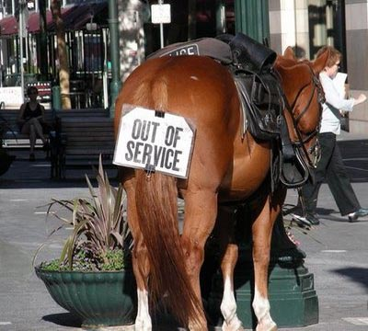
DEMO: ASP.NET WEB API

Slide 26
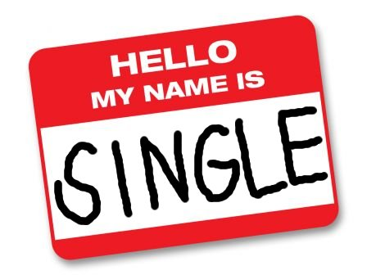

ASP.NET SPA

Slide 27

SPA
Single Page Application (SPA)
Maintain navigation
Fits on single web page
Persist important state on the client
Fully loaded in the initial page load
Download features only if
required

Slide 28

KnockoutJS
Simplify dynamic JavaScript Uis by applying the Model-View-ViewModel(MVVM) pattern
Easily associate DOM elements with model data using a concise, readable syntax
When your data model's state changes, your UI updates automatically
Implicitly set up chains of relationships between model data, to transform and combine it

Slide 29

DEMO: ASP.NET SPA Code Camper

Slide 30


SignalR

Slide 31
SignalR
Simplifies the process of adding real-time web functionality
SignalR uses Websockets when it is supported by the browser and the server
SignalR provides a simple ASP.NET API for creating server-to-client remote procedure calls (RPC)
SignalR also includes API for connection management

Slide 32
Introduction to ASP.NET MVC 4
http://schoolacademy.telerik.com

Slide 33
Homework(1)
Create a database for storing information about a Movies – Title, Director, Year, Leading Male Role, Leading Female Role and their age, Studio, Studio Address.
Using ASP.NET Web Api create a service that allows you to perfom a CRUD operations on your database tables
Using ASP.NET MVC create an application that consumes your services via Ajax.

Slide 34




Free Trainings @ Telerik Academy
“C# Programming @ Telerik Academy
csharpfundamentals.telerik.com
Telerik Software Academy
academy.telerik.com
Telerik Academy @ Facebook
facebook.com/TelerikAcademy
Telerik Software Academy Forums
forums.academy.telerik.com

